Slide 1

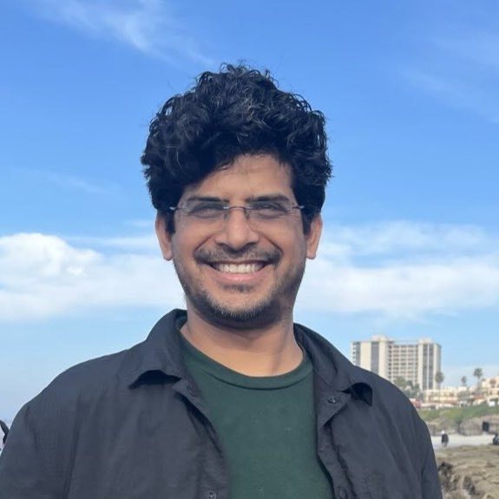
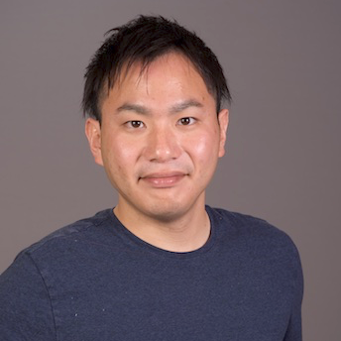
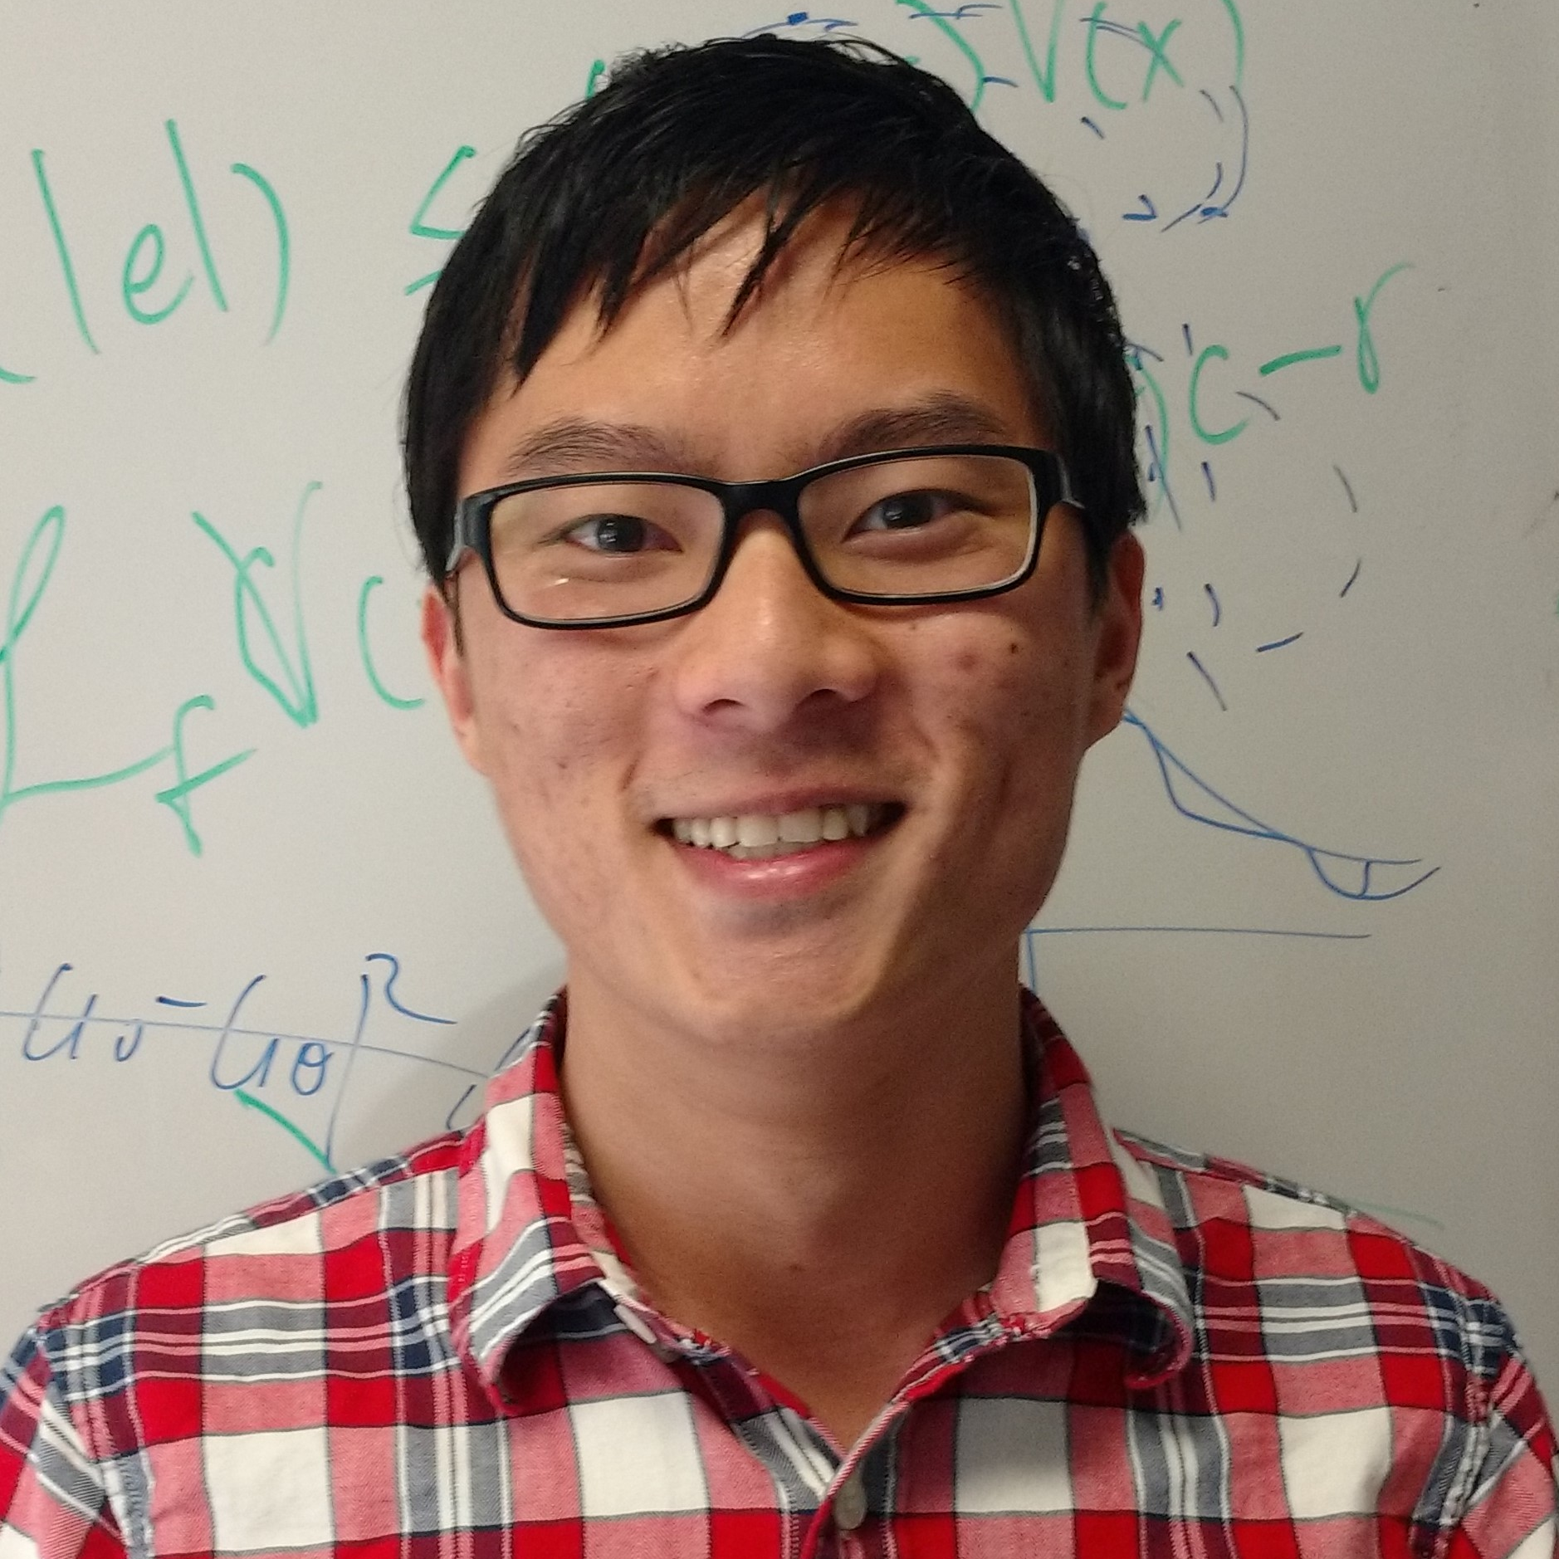
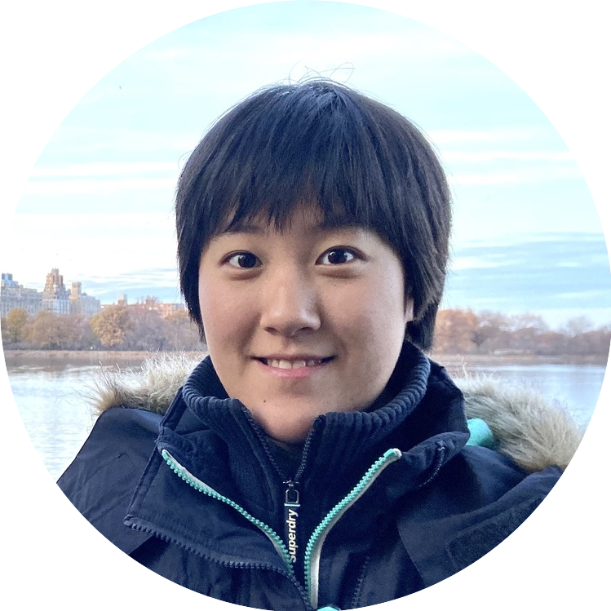
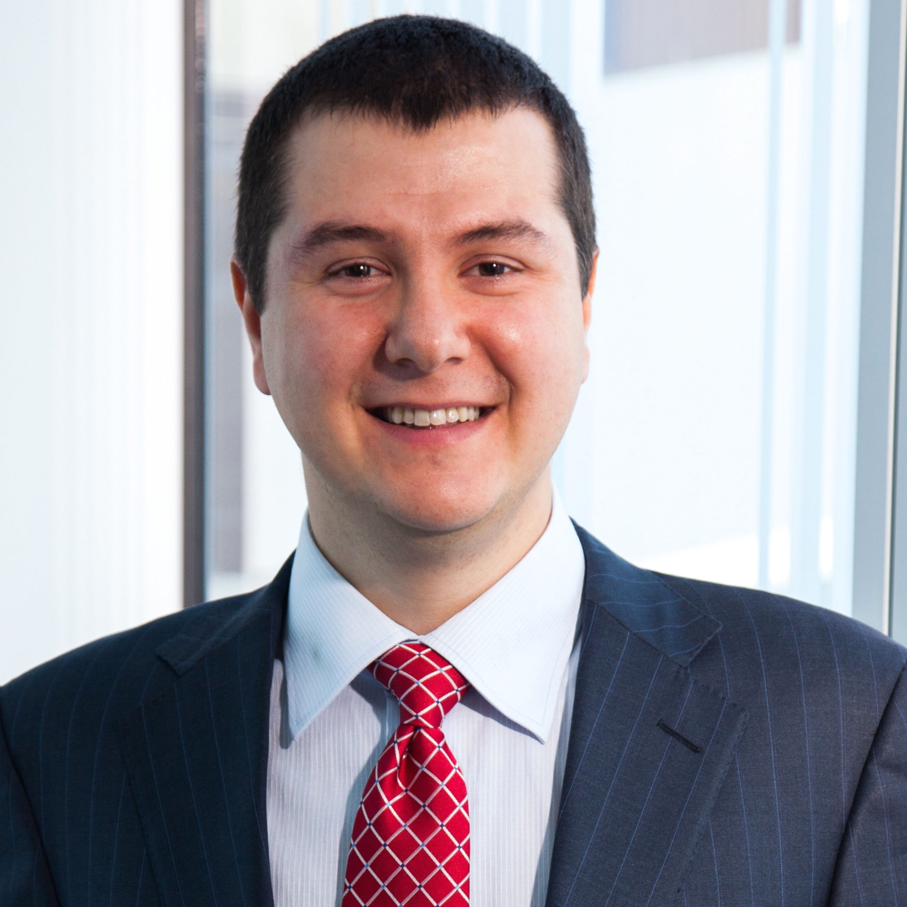
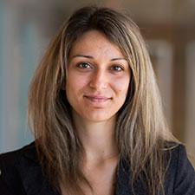
ICRA 2025 Workshop on
Robot Safety under Uncertainty from “Intangible” Specifications
Organizers
Vikas Dhiman
U. of Maine
Shumon Koga
Kobe U.
Pio Ong
Caltech
May 19th 2025, Atlanta, Georgia, USA
Webpage: https://iscicra25.github.io/
Zoom Meeting ID: 851 3819 9927; Passwd: 218969
Yiwei Lyu
CMU
Nikolay Atanasov
UCSD
Dimitra Panagou
U. of Michigan
Notes:
Thank you everyone for attending

Slide 2
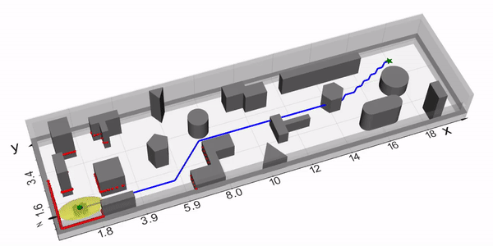
Workshop’s Scope
Robot Safety
Control Barrier Function (CBF)
Reachability Analysis
Model Predictive Control (MPC)
✔️ Formal guarantees. ❌ Needs explicit formulation of safety constraint
Challenges
⚠️Some safety constraints are intangible
How to infer from data/demonstration?
How to describe by natural language?
⚠️ Robot/Environment are uncertain
How to quantify uncertainty?
How to define safety under stochasticity?
⚠️ Perception is not always perfect
How to estimate the environment from raw sensors?
How to reason about semantics?
Notes:
-- First mention safety including collision avoidance and other constarints as well and mention state-ofthe art
-- Emphasize the knowledge of h, s in the explicit formulation

Slide 3
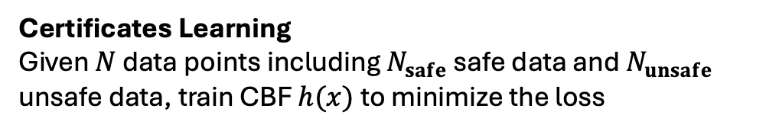
Learning Safety from Demonstrations
Certificates Learning
Given $N$ data points including $N_{safe}$ safe data and $N_{unsafe}$ unsafe data, train CBF $h(x)$ to minimize the loss
where $r(x)≥0$ is the solution to

Slide 4


Natural Language with Logic
STL formulae with Boolean and temporal operations
G: Globally, F: Eventually, U: Until
denotes signal $ξ$ satisfies $φ$ at time $t$
MPC with STL constraint solved by Mixed-Integer Programming
Uncertainty quantification by conformal prediction
i.i.d. random variables
For a given $δ∈(0,1)$, it holds that
where
sorted in
non-decreasing order

Slide 5
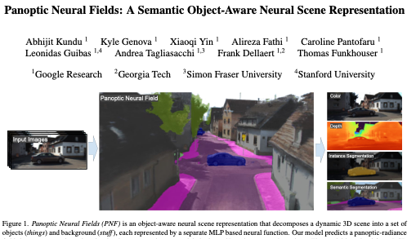
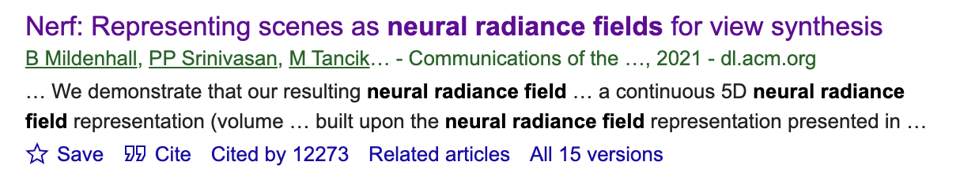
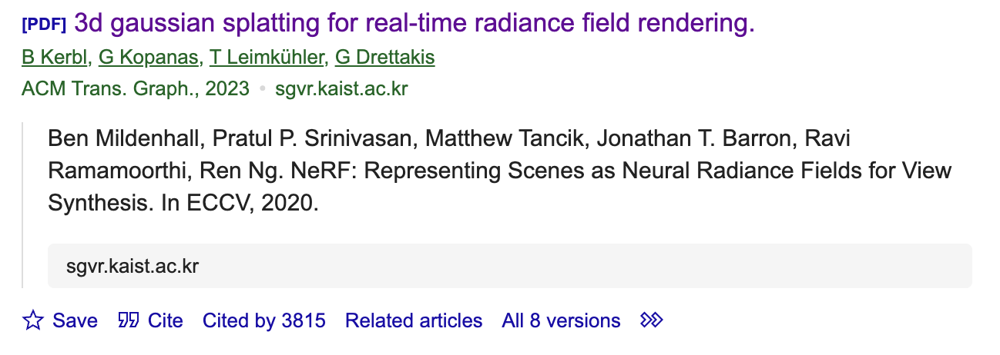
Semantics and Perception Uncertainty
Trends on Perception for 3-D Rendering
What are formal guarantees on perception accuracy, robustness, and uncertainty measure to be used for safety-critical scenarios?

Slide 6
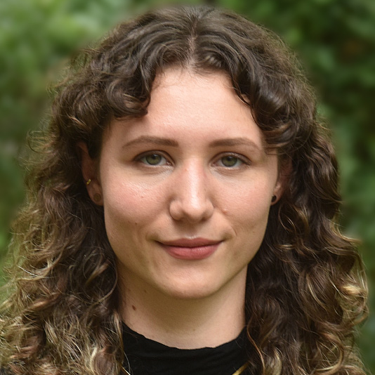

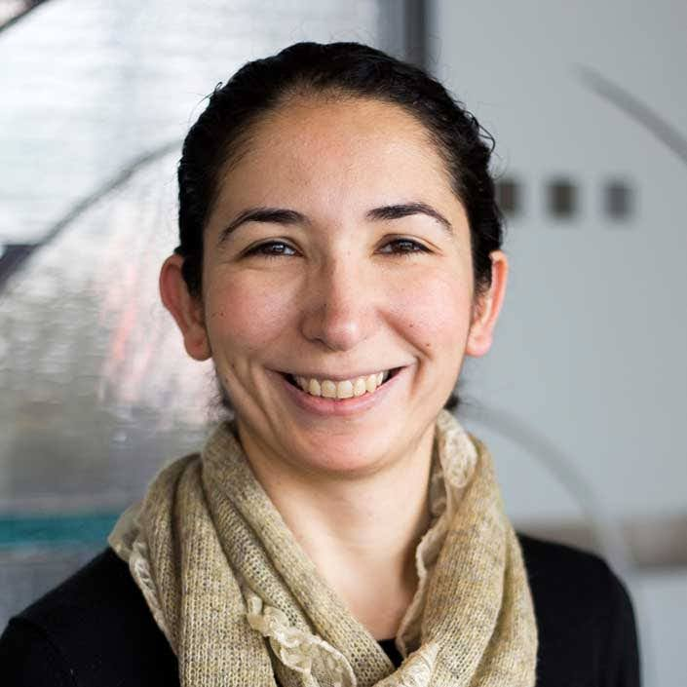
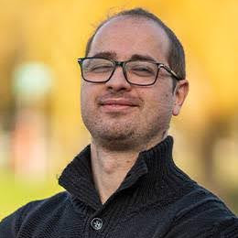
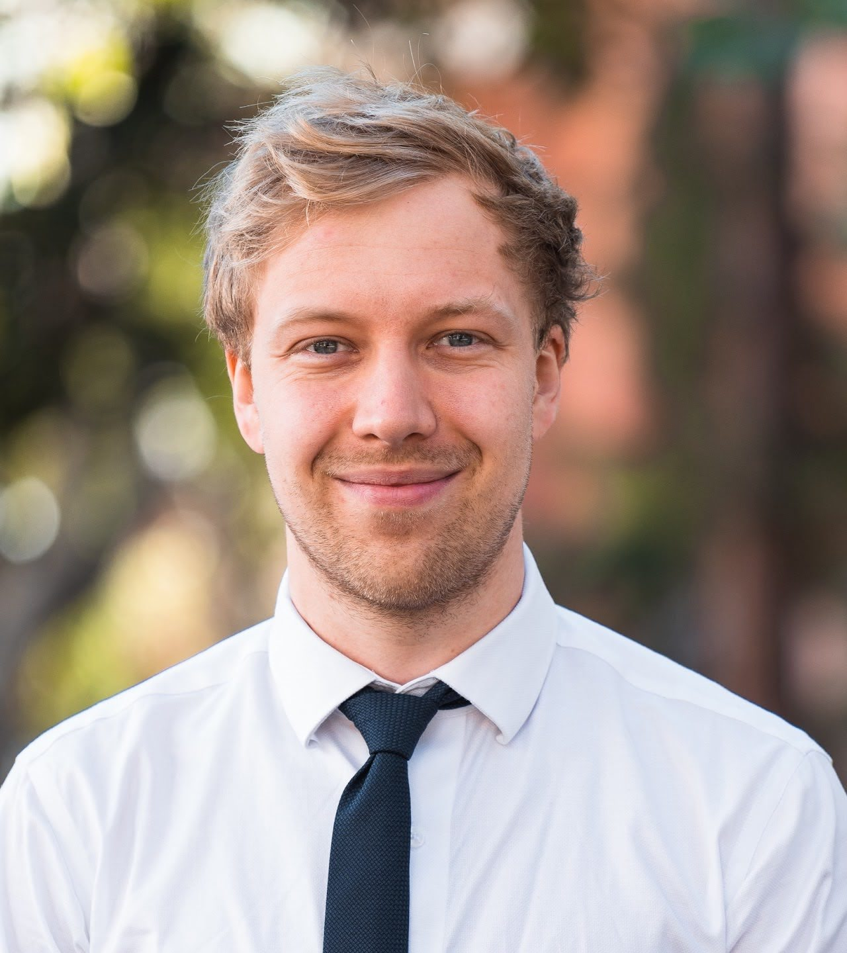

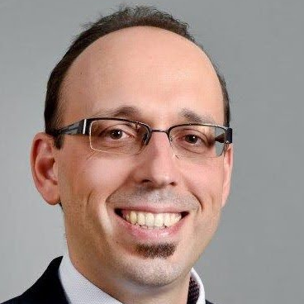
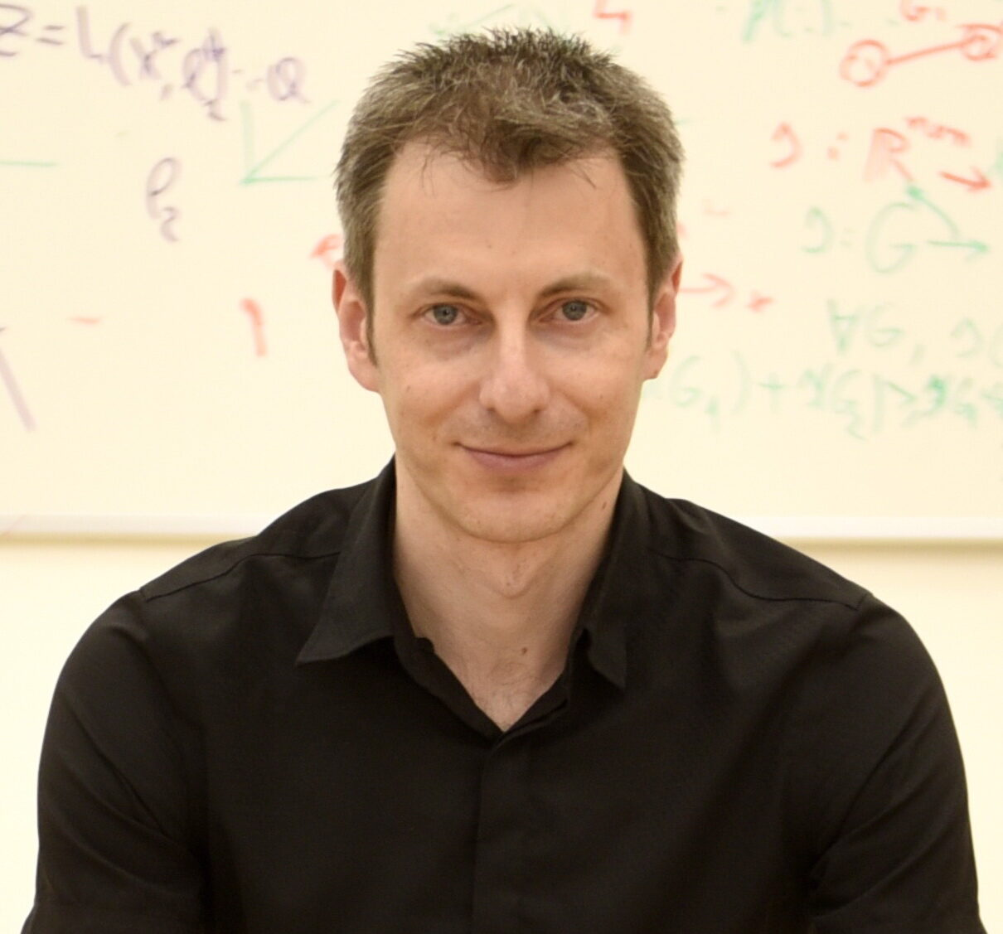
Invited Speakers
Andrea Bajcsy
CMU
Lei Zheng
HKUST(GZ) / CMU
Necmiye Ozay
U. of Michigan
Luca Laurenti
TU Delft
Lars Lindemann
USC
Ayoung Kim
Seoul National University
Georgios Fainekos
Toyota Motor
Vadim Indelman
Technion - Israel Inst. Tech.

Slide 7
Schedule
Time | Content
09:00-09:15 AM | Registration, welcome, and opening remarks
09:15-10:00 AM | Andrea Bajcsy “Towards "Open-World" Robot Safety: Unifying Generative AI and Control Systems Safety”
10:00-10:30 AM | Lei Zheng (PhD) “Towards Real-time Safe Optimization for Autonomous Vehicles under Uncertainties”
Coffee Break
11:00-11:45 AM | Necmiye Ozay “Learning Temporal Logic Constraints from Multi-Modal Human Data”
11:45-12:30 PM | Luca Laurenti “Safety of Stochastic Systems: From Stochastic Barrier Functions to Uncertain Abstractions”
Lunch Break
01:45-02:30 PM | Lars Lindemann “Safe Control of Learning-Enabled Autonomous Systems using Conformal Prediction”
02:30-03:30 PM | Poster Session
03:30-04:15 PM | Ayoung Kim “Safety in Robot Navigation using Sensors beyond the Visible Spectrum”
04:15-05:00 PM | Georgios Fainekos “Searching Perception Data Streams For Testing/Training Behaviors”
05:00-05:15 PM | Vadim Indelman “Robot Safety in Partially Observable Domains: Challenges and Opportunities”
05:15-05:30 PM | Asynchronous Q&A and closing remarks

Slide 8
Posters (Papers uploaded in website: Check it out!)
Gilbert Bahati, Aaron Ames, "Safe Set Synthesis with Tunable Boundary Gradients via Poisson Safety Functions"
Lukas Brunke, Yanni Zhang, Ralf Römer, Jack Naimer, Nikola Staykov, SiQi Zhou, Angela P. Schoellig "Semantically Safe Robot Manipulation: From Semantic Scene Understanding to Motion Safeguards"
Aaron O. Feldman, D. Isaiah Harp, Joseph Duncan, Mac Schwager "Conformal Safety Monitoring for Flight Testing: A Case Study in Data-Driven Safety Learning"
Elias Fontanari, Gianni Lunardi, Matteo Saveriano, Andrea Del Prete, "Receding-Constraint and Parallel-Constraint Model Predictive Control: novel methods to enhance Safety in Nonlinear Control"
Sejin Kwon, Sang Jun Lee, Wookyong Kwon, Yongsik Jin, "Event-Triggered Deep Q-Network Control for Driving Safety and Performance in Vision-Based Autonomous Vehicles"
Yong-Hoon Lee, Keuntae Kim, Jaehyun Park, Chung Hyuk Park, Hae-Won Park, "Soft Contact Model for Robust Locomotion of Legged Robots"
Xusheng Luo, Changliu Liu, "Hierarchical Temporal Logic Specifications for Abstract Safety Tasks"
Federico Masiero*, Sandro Ferrari*, Giuliano Giampietro, Marilena Vendittelli, and Lorenzo Masia, "A Collaborative Robot with Magnetic Perception"
Evangelos Psomiadis, Panagiotis Tsiotras, "Hierarchical Semantic Path-Planning in 3D Scene Graphs"
Xinyi Wang, Taekyung Kim, Bardh Hoxha, Georgios Fainekos, Dimitra Panagou, "Adaptive Risk Control for Social Navigation in Uncertain Crowded Environments"
Lizhi Yang, Blake Werner, Ryan Kazuo Cosner, David Fridovich-Keil, Preston Culbertson, Aaron Ames, "Towards Dynamical Safety on Humanoids with Stochastic Controllers with SHIELD"
Zhouyu Zhang, Chih-Yuan Chiu, and Glen Chou, "Constraint Learning in Multi-Agent Dynamic Games from Demonstrations of Local Nash Interactions"

Slide 9
Closing Remarks
Session 1: Capturing “Intangible” Safety Specifications
Andrea: To avoid constructing a complicated state space and dynamics, encode visual observations in latent space and construct safety value function in latent space
Andrea: You cannot safeguard against what you cannot predict. Use epistemic uncertainty of latent world model to keep the state in distribution.
Lei: Safety problems can be decomposed into subproblems via ADMM
Lei: We need to have several contingency plans in case unexpected conditions occur
Necmiye: We should not only be learning models from data. Specifications matter!!
Necmiye: Optimality is a strong prior when learning from limited data
Necmiye: Learning multi-stage tasks for stochastic systems -- memory structure matters. Reward machines can be used to capture rewards.
Necmiye: Combining human feedback and logic increases expressiveness without sacrificing correctness. Preference ranking enables learning weighted temporal logics such that induced quantitative semantics agree with the desired human ranking

Slide 10
Closing Remarks
Session 2: Safe Control of Stochastic and Learning-Enabled Systems
Luca: Propagating Wasserstein balls through nonlinear dynamics can be approximated with an upper-Wasserstein bound. Under certain conditions, the Wasserstein balls reach a fixed point and may be used together with MPC.
Luca: Wasserstein uncertainty quantification allows doing probabilistic reachability and, with discrete distributions, the computation leads to an LP.
Lars: Conformal prediction is a computationally efficient, minimal assumptions way of obtaining probabilistic guarantees with uncertain constraints or in dynamic environments
Lars: Choosing the nonconformity score is important for the tightness of the guarantees
Vadim: Coupling between semantics, geometry, and viewpoint need to be considered when capturing uncertainty
Vadim: Without any assumptions, there is an exponential number of hypotheses when predicting future evolutions. Value function over reduced hypothesis set in POMDP models can be bounded online!
Vadim: Limited data sharing capabilities can lead to a lack of coordination and unsafe actions in multi-robot teams

Slide 11
Closing Remarks
Session 3: Safety in Robot Perception and Real-World Robot Deployment
Ayoung: In challenging environments, relying on vision only for safety is not reasonable.
  Tracking radar is a promising sensor that can achieve almost LiDAR-level performance and can be integrated with inertial and legged odometry measurements.
  Thermal cameras, if calibrated carefully, enable depth prediction, object detection, and accurate SLAM in challenging environments
Georgios: Videos can be used to test against corner cases
  Dashcam video to probabilistic program to simulated video and to closing the loop to generate interesting scenarios
  STREM: Spatial and Spatiotemporal Regex for interesting scenarios in the S4+ logic and DFAs: every atomic proposition is a topological formula
  Staying close to regex syntax allows using language models to translate natural language to STREM
  What makes a scenario interesting?

